Slide 1
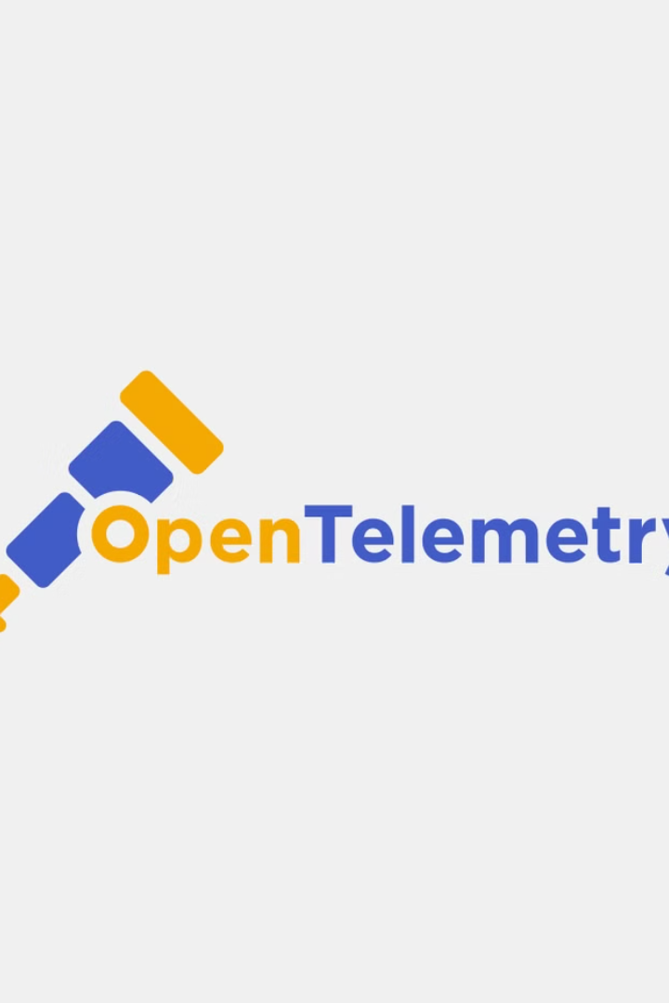
Open Telemetry: A Unified Observability Platform
Open Telemetry is an open-source observability framework that provides a comprehensive, vendor-agnostic solution for collecting, processing, and exporting telemetry data from applications and infrastructure. It aims to simplify the complex landscape of observability tools and enable organizations to gain deeper insights into the health and performance of their systems.

Slide 2
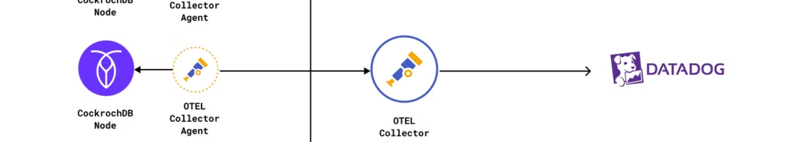
What is Open Telemetry?
1
Observability Standard
2
Unified Approach
3
Polyglot Support
By providing a unified set of APIs, SDKs, and data formats, Open Telemetry simplifies the complex landscape of observability tools and enables organizations to seamlessly integrate data from different sources.
Open Telemetry supports a wide range of programming languages, including Java, Python, Go, Node.js, .NET, and more, making it easy to instrument applications across the technology stack.
Open Telemetry is a vendor-neutral observability framework that provides a standardized way to collect, process, and export telemetry data from applications and infrastructure.

Slide 3
The Need for Unified Observability
Fragmented Tooling
Increased Complexity
Vendor Lock-in
Traditionally, organizations have relied on a patchwork of disparate observability tools, each with its own data formats and integration requirements, leading to silos and fragmented data.
As modern applications become more distributed, containerized, and cloud-native, the need for a unified observability solution has become more pressing to address the increased complexity of these systems.
Many existing observability tools are vendor-specific, which can lead to vendor lock-in and limit an organization's flexibility to choose the best-fit solutions for their needs.

Slide 4
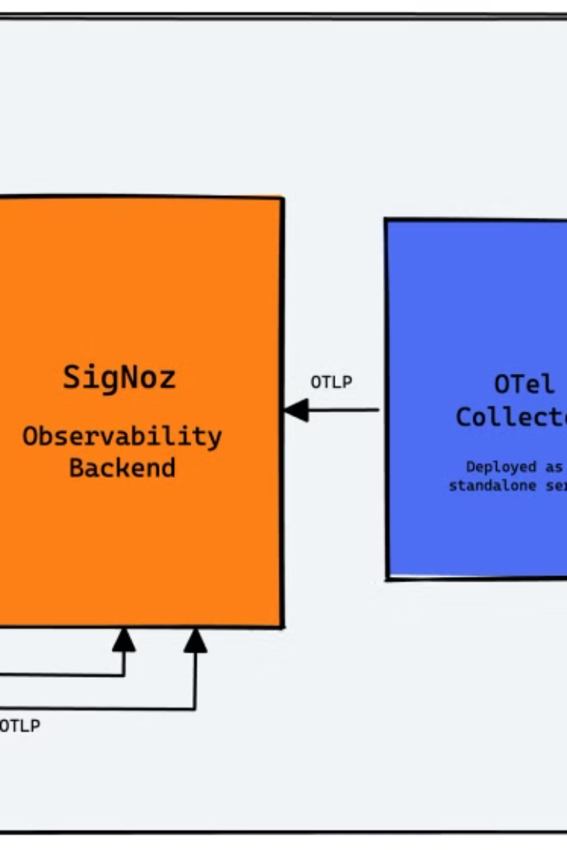
Open Telemetry Components
1
Instrumentation
Open Telemetry provides SDKs and libraries for instrumenting applications and infrastructure to collect telemetry data, including traces, metrics, and logs.
2
Data Collection
The Open Telemetry Collector gathers and processes telemetry data from various sources, normalizing and enriching the data before exporting it to backend systems.
3
Data Export
Open Telemetry supports a wide range of backend systems, including popular observability platforms, enabling organizations to export their data to the tools of their choice.

Slide 5
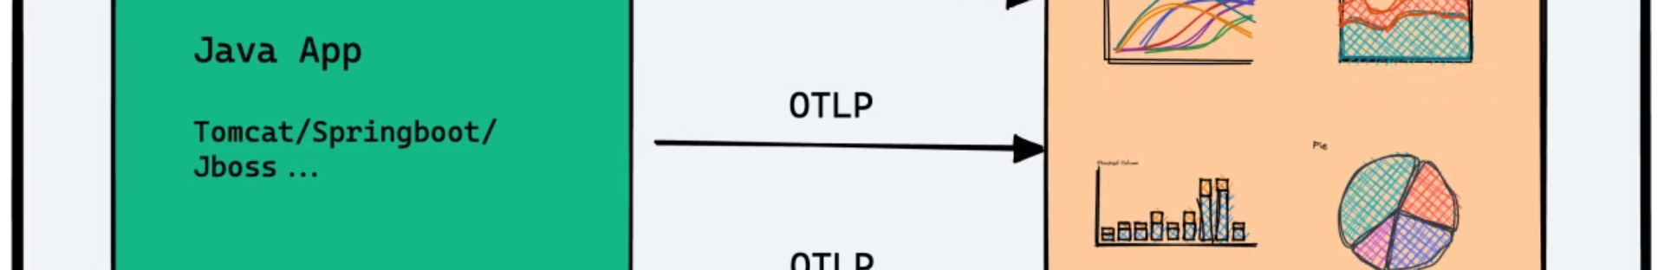
Instrumentation and Data Collection
Automatic Instrumentation
Custom Instrumentation
Open Telemetry provides automatic instrumentation for popular frameworks, libraries, and runtimes, reducing the manual effort required to instrument applications.
For more advanced use cases, Open Telemetry also supports custom instrumentation, allowing developers to instrument their applications with fine-grained control over the data collected.
Distributed Tracing
Metrics and Logs
Open Telemetry's distributed tracing capabilities enable organizations to understand the end-to-end flow of requests across complex, microservices-based architectures.
In addition to traces, Open Telemetry also supports the collection of metrics and logs, providing a comprehensive view of application and infrastructure performance.

Slide 6
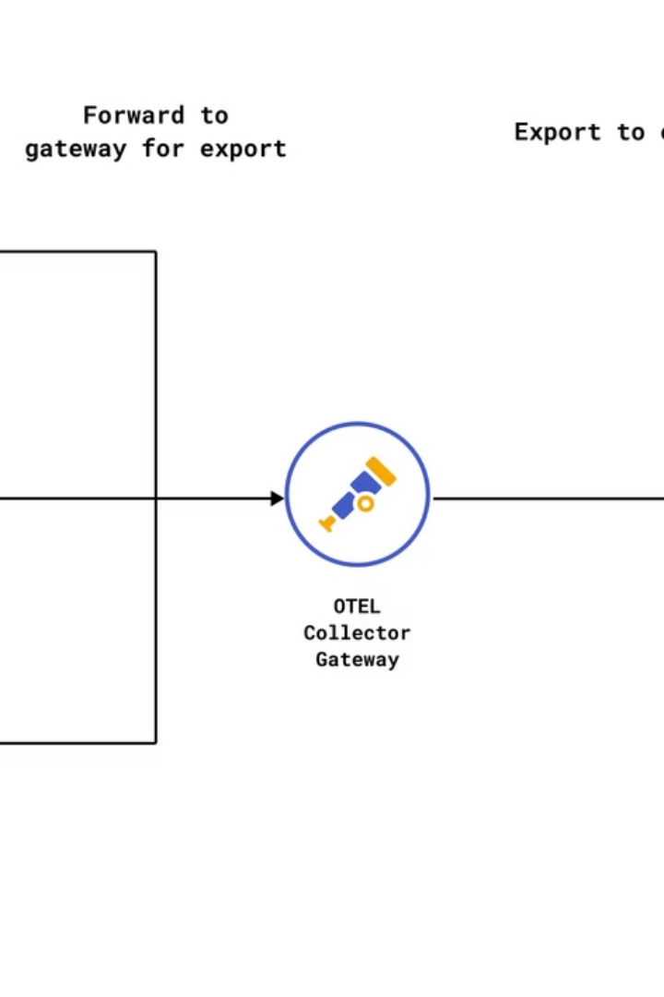
Data Processing and Transformation
1
Normalization
The Open Telemetry Collector normalizes the collected data, ensuring consistent data formats and structures across different sources and backends.
2
Enrichment
The Collector can enrich the collected data with additional context, such as metadata, tags, and labels, to provide more meaningful insights.
3
Filtering and Sampling
Open Telemetry supports advanced data filtering and sampling capabilities, allowing organizations to optimize data collection and reduce costs associated with observability data.

Slide 7
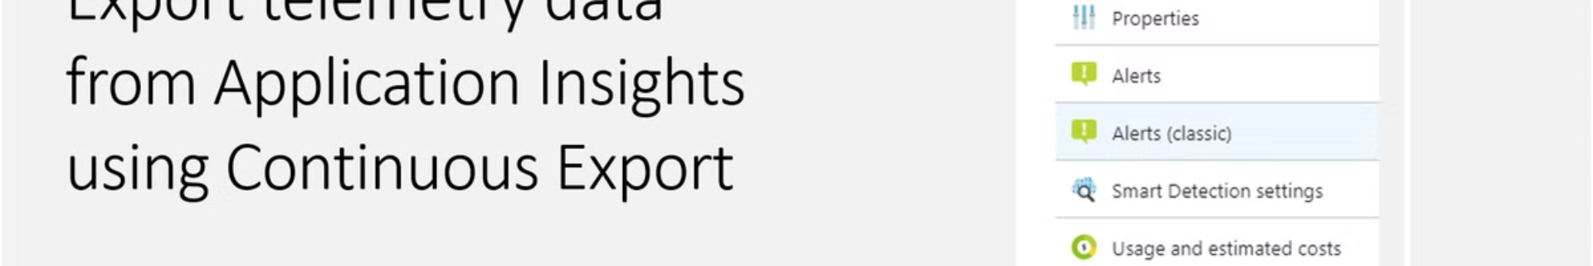




Data Export and Backend Integration
Cloud Observability
On-Premises Solutions
Flexible Data Export
Interoperability
Open Telemetry supports seamless integration with leading cloud-based observability platforms, such as AWS, Azure, and Google Cloud.
The Collector supports a wide range of data export formats, including OpenTelemetry, Prometheus, and Jaeger, ensuring compatibility with a variety of backend systems.
Open Telemetry's vendor-neutral approach promotes interoperability, allowing organizations to choose the best-fit observability tools for their needs.
It also integrates with on-premises observability tools, including Prometheus, Jaeger, and Zipkin, enabling organizations to leverage their existing investments.

Slide 8

Performance and Scalability
Scalability
The Open Telemetry Collector is designed to handle high-volume data streams, with support for load balancing, sharding, and failover capabilities.
Efficiency
Open Telemetry's efficient data processing and compression algorithms help reduce the resource overhead and costs associated with observability data.
Reliability
The Collector's robust error handling and retry mechanisms ensure that telemetry data is reliably collected and exported, even in the face of transient failures.
Flexibility
Open Telemetry's modular architecture allows organizations to scale and configure the Collector to meet their specific performance and resource requirements.

Slide 9
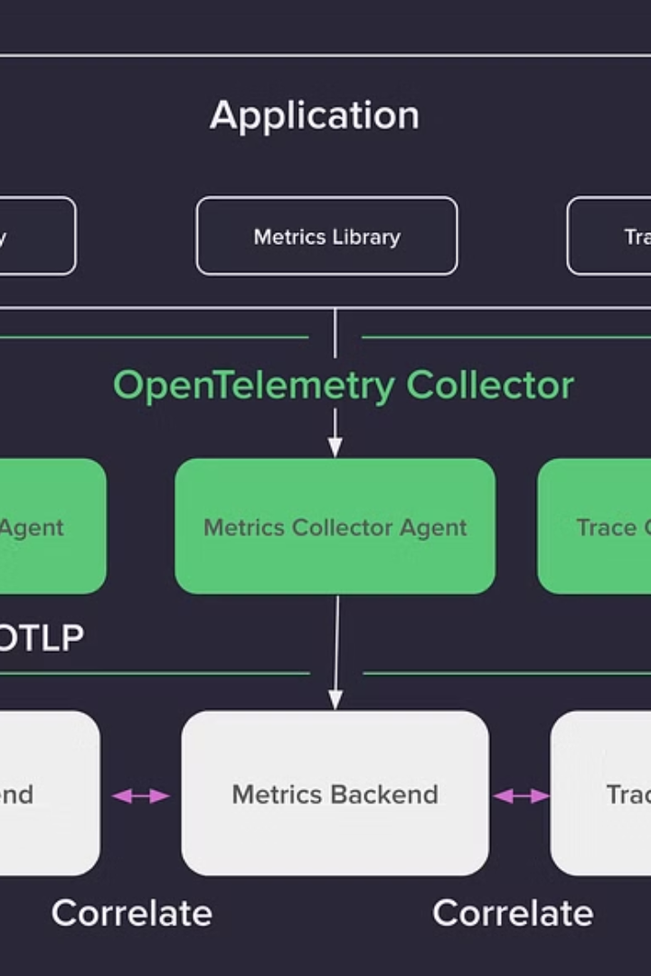



Open Telemetry Ecosystem and Adoption
Broad Adoption
Open Telemetry is backed by a growing community of contributors, including major cloud providers, observability vendors, and leading technology companies.
Ecosystem Integration
Open Telemetry is being widely adopted and integrated across the observability ecosystem, with support from tools like Prometheus, Jaeger, Zipkin, and many others.
Standardization Efforts
Open Telemetry is working towards becoming the industry standard for observability, with efforts to standardize data formats, protocols, and best practices.

Slide 10
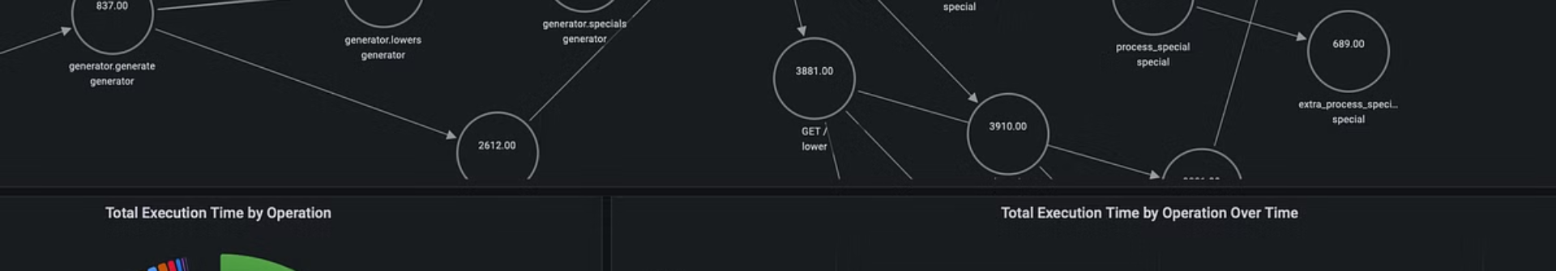
The Future of Open Telemetry
1
Continued Evolution
2
Increased Adoption
3
Enhanced Capabilities
As the observability landscape continues to evolve, Open Telemetry is well-positioned to adapt and expand its capabilities to address emerging needs and technologies.
With growing support from the industry and the community, Open Telemetry is expected to see increased adoption, driving the standardization and unification of observability practices.
Future developments may include expanded support for emerging observability data types, such as logs, security, and network data, as well as advancements in areas like advanced analytics and AI-driven insights.

Slide 11
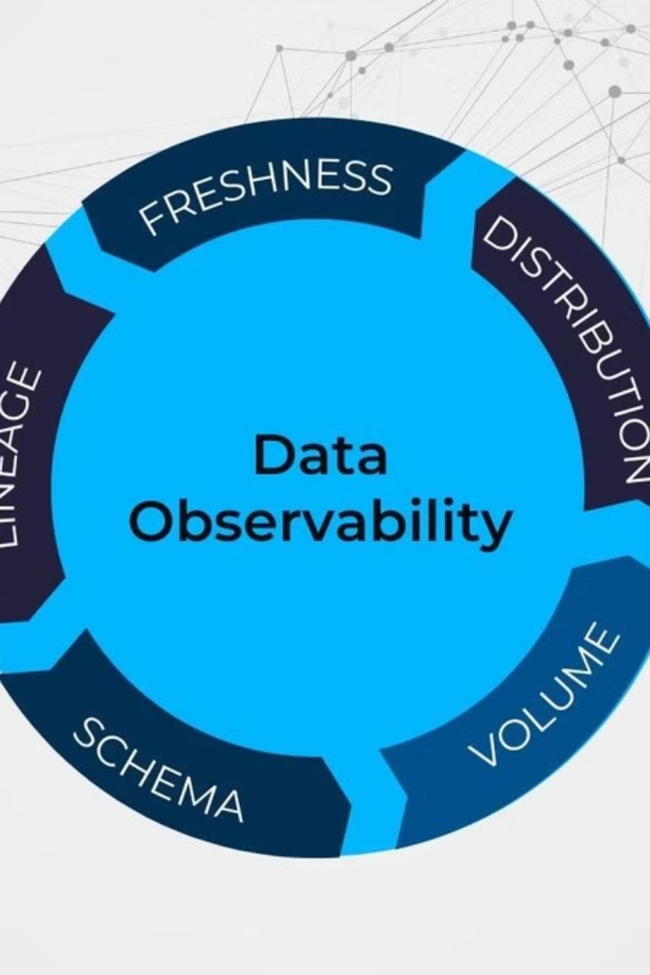
Logs, Metrics, and Traces: The Three Pillars of Observability
Observability is essential for understanding and optimizing the performance of modern, distributed applications. The three key components - logs, metrics, and traces - provide the necessary data and insights to achieve this goal.

Slide 12
Understanding the Difference Between Logs, Metrics, and Traces
Logs
Metrics
Traces
Logs capture detailed information about events and errors that occur within an application, providing the full context needed for troubleshooting.
Metrics quantify the overall health and performance of a system, allowing you to monitor key indicators and identify trends over time.
Traces provide a comprehensive view of a transaction's journey through a distributed system, enabling end-to-end visibility and performance analysis.

Slide 13
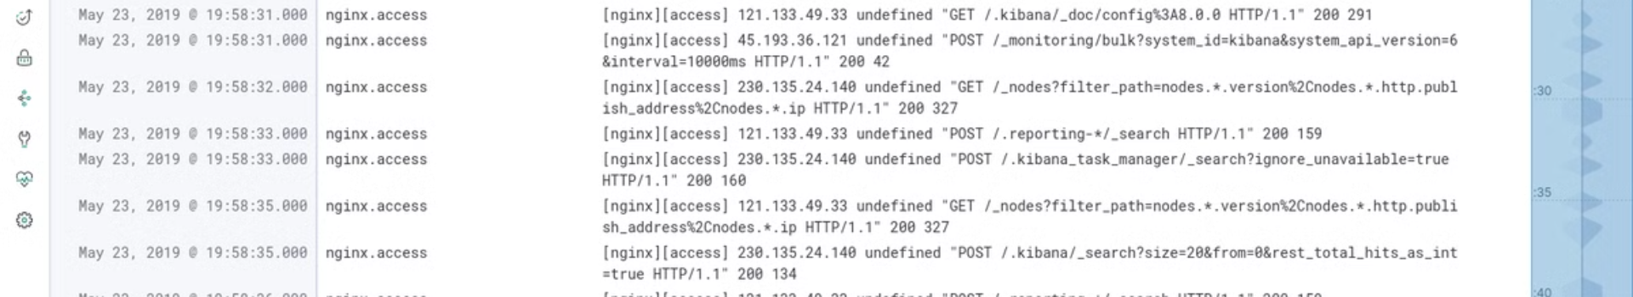
Logs: Capturing the Full Context of Your Application
1
Detailed Information
2
Flexible Filtering
3
Historical Analysis
Logs record a wealth of contextual data, including error messages, stack traces, and user actions, to enable thorough troubleshooting.
Logs can be easily filtered and searched to isolate relevant information for specific issues or time periods.
Logs provide a comprehensive audit trail, allowing you to review past events and understand the evolution of your system.

Slide 14
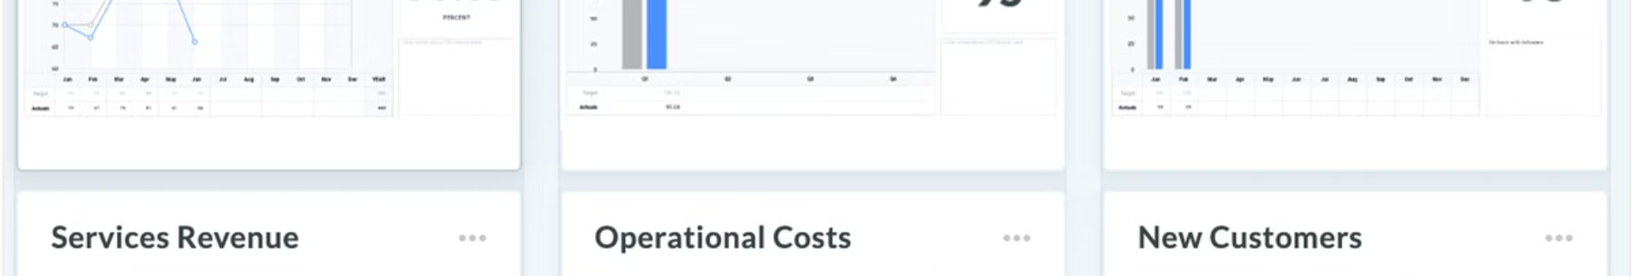
Metrics: Quantifying the Health and Performance of Your System
Key Indicators
Trend Analysis
Metrics like CPU utilization, response times, and error rates provide a numerical snapshot of your system's health.
Tracking metrics over time enables you to identify performance patterns, detect anomalies, and proactively address issues.
Data-Driven Decisions
Alerting and Monitoring
Metrics empower you to make informed, data-backed decisions about optimizing your application and infrastructure.
Metrics can be used to trigger alerts and drive automated monitoring systems to quickly identify and respond to problems.

Slide 15
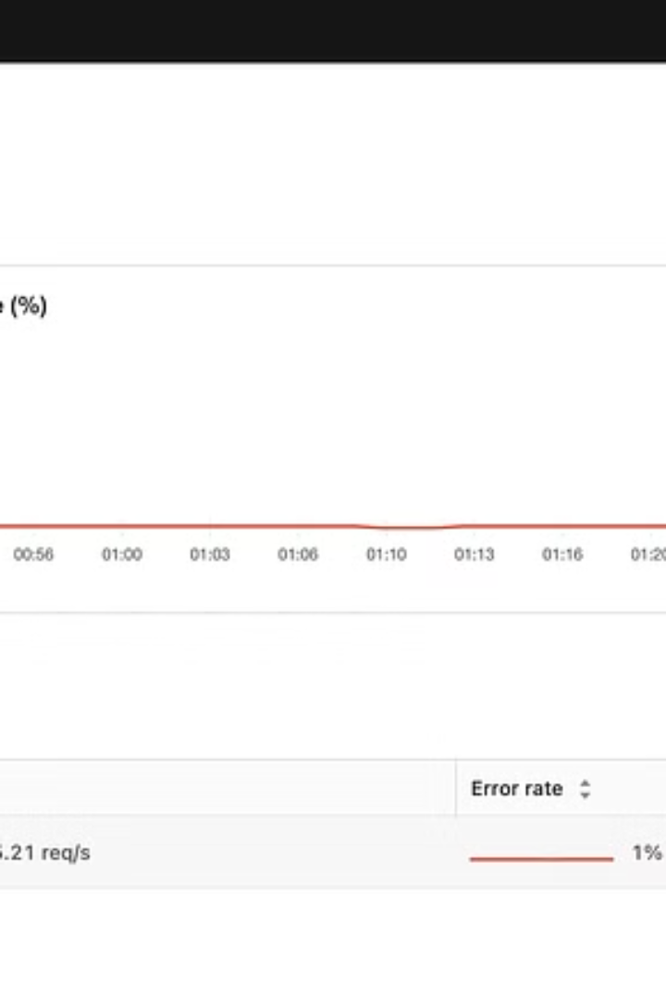



Traces: Connecting the Dots for End-to-End Visibility
Request Origination
Traces capture the initial request and its journey through the distributed system.
Microservice Interactions
Traces follow the request as it flows through various microservices, providing visibility into the entire transaction.
Performance Analysis
Traces enable in-depth analysis of latency, errors, and other performance metrics at each step of the transaction.

Slide 16
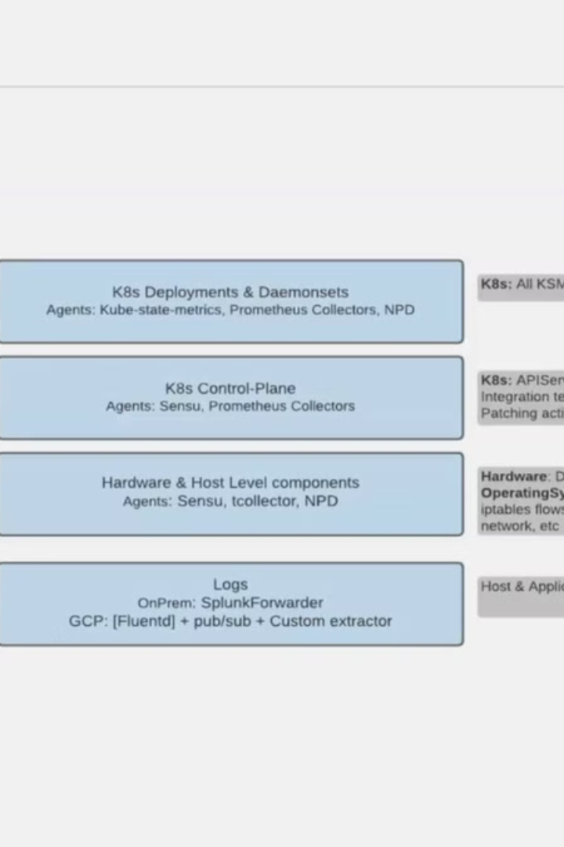



Leveraging the Power of Observability in Troubleshooting
Isolate Issues
Quickly identify the root cause of problems by correlating logs, metrics, and traces.
Perform Root Cause Analysis
Understand the full context of an issue and its impact on the system.
Optimize Performance
Identify bottlenecks and opportunities for improvement based on observability data.

Slide 17
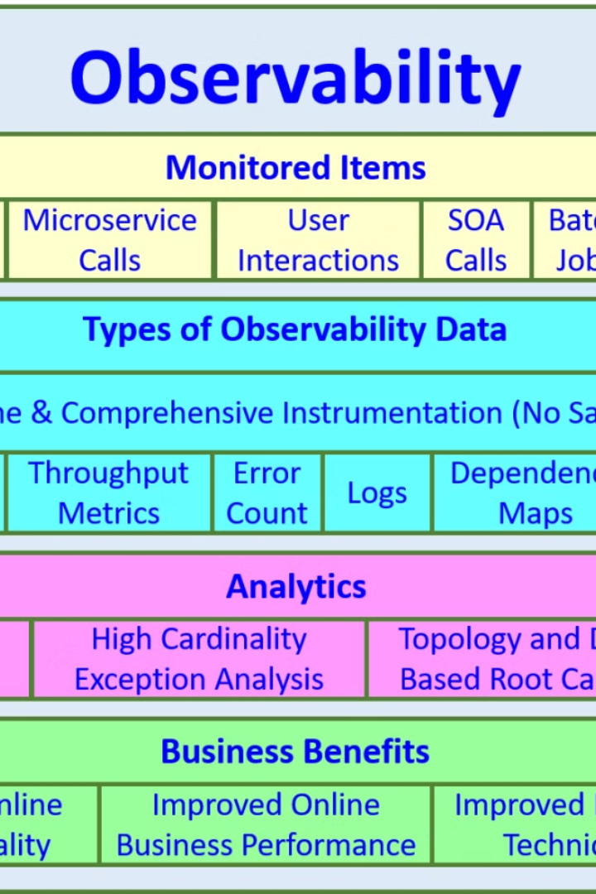
Best Practices for Implementing Effective Logging, Metrics, and Tracing
1
Standardize Logging
Establish consistent logging formats and practices across your organization.
2
Define Key Metrics
Identify the most important metrics to track for your specific application and business needs.
3
Implement Distributed Tracing
Integrate tracing capabilities into your application architecture to gain end-to-end visibility.

Slide 18
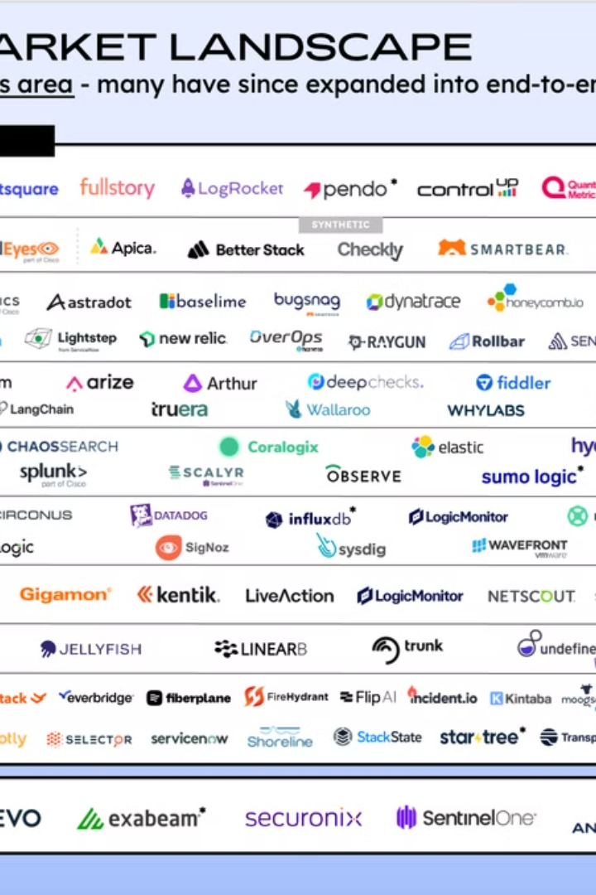
The Future of Observability: Trends and Emerging Technologies
1
AI-Powered Insights
2
Unified Observability Platforms
Machine learning and artificial intelligence will enable more advanced anomaly detection and root cause analysis.
Integrated solutions will provide a centralized view of logs, metrics, and traces for holistic observability.
3
Edge Computing Monitoring
Observability will extend to the edge, enabling visibility into IoT devices and decentralized infrastructure.

Slide 19
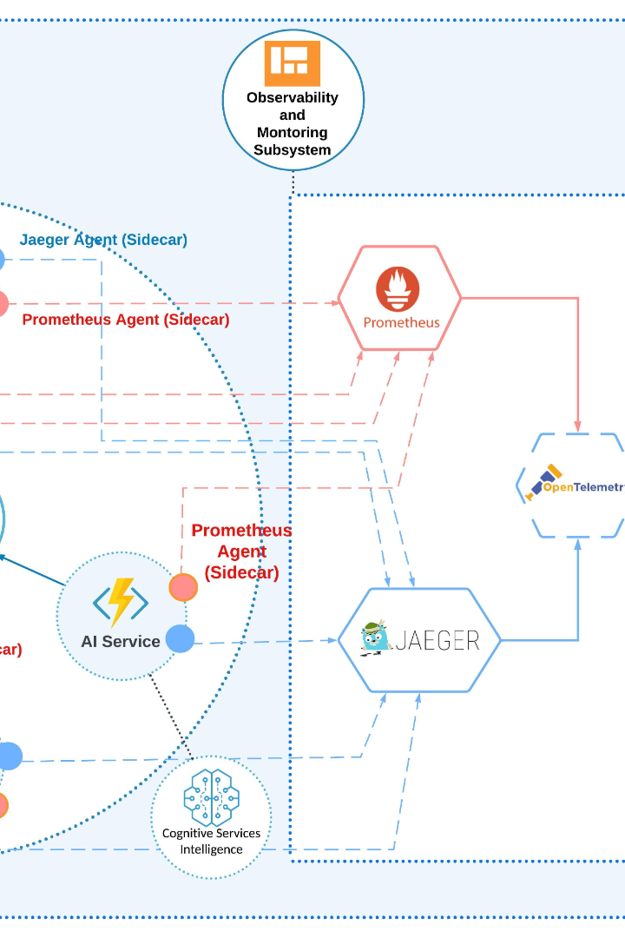
Distributed Tracing: Unlocking the Power of Observability
In today's world of complex, cloud-native applications and microservices architectures, understanding the behavior and performance of your systems has become increasingly challenging. Distributed tracing emerges as a powerful tool to tackle this complexity, providing a comprehensive view of your distributed applications and enabling deep observability into your systems.

Slide 20
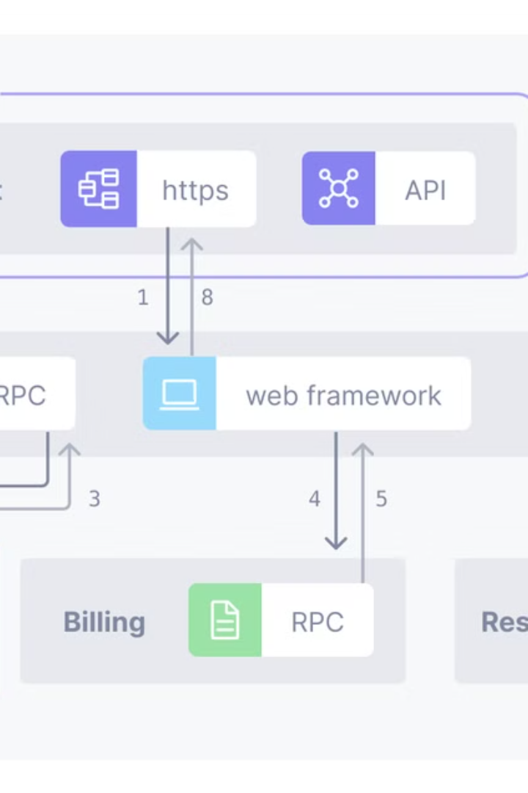
What is Distributed Tracing?
1
Tracking Requests Across Services
2
Providing Contextual Information
Distributed tracing is a technique that allows you to follow a request as it flows through a distributed system, across multiple services, databases, and other components.
By capturing metadata about each step of the request, distributed tracing provides valuable context about the execution of the request, including timing, errors, and other relevant details.
3
Enabling Observability
This contextual information gleaned from distributed tracing empowers developers and operations teams to achieve a deeper understanding of their systems, identifying performance bottlenecks, debugging issues, and optimizing application behavior.

Slide 21
The Challenges of Microservices and Distributed Systems
Increased Complexity
Lack of Visibility
Debugging Difficulties
As applications are broken down into smaller, independently deployable services, the overall system complexity increases exponentially, making it challenging to understand the end-to-end flow of a request.
Traditional monitoring tools often fall short in providing visibility into the intricate interactions between services, leaving teams struggling to pinpoint the root cause of issues.
When a problem arises, teams are faced with the daunting task of sifting through logs and traces from multiple services to identify the source of the issue, a process that can be time-consuming and inefficient.

Slide 22
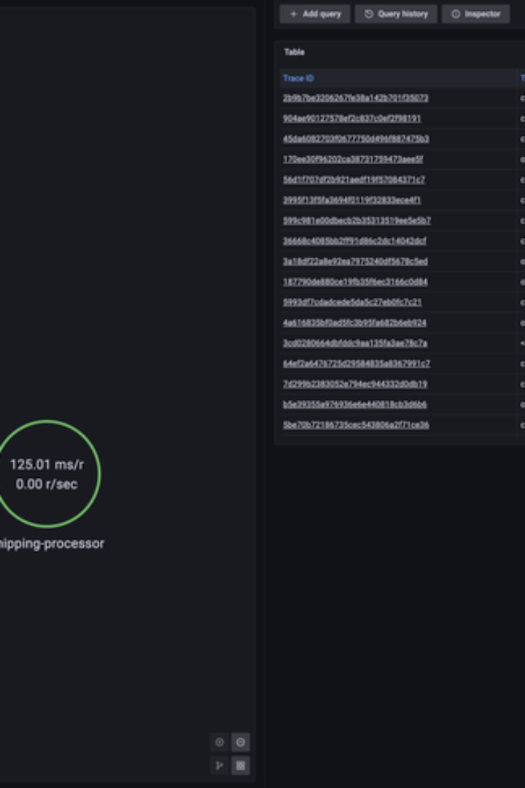
Key Benefits of Distributed Tracing
Improved Observability
Faster Troubleshooting
Distributed tracing provides a comprehensive view of your distributed application, enabling you to understand the behavior and performance of your systems in a way that traditional monitoring tools cannot.
By tracing the path of a request through your services, you can quickly identify the source of an issue, pinpoint bottlenecks, and resolve problems more efficiently.
Enhanced Collaboration
Optimization Opportunities
Distributed tracing data can be shared across teams, fostering collaboration and enabling a shared understanding of the application's behavior, leading to improved decision-making and better overall system performance.
Analyzing distributed tracing data can uncover optimization opportunities, helping you identify areas for improvement and drive performance enhancements across your application.

Slide 23
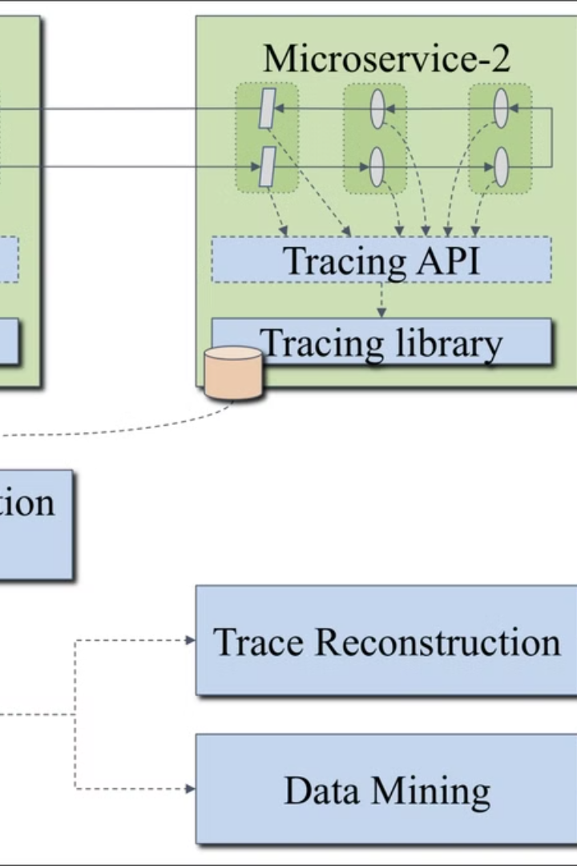
How Distributed Tracing Works
1
Instrumentation
Distributed tracing begins with instrumenting your application code to capture and propagate trace data as requests flow through your services.
2
Data Collection
The instrumented application emits trace data, which is then collected and aggregated by a distributed tracing system, such as Jaeger or Zipkin.
3
Data Analysis
The distributed tracing system analyzes the collected data, correlating traces and creating a comprehensive view of the request's journey through your application.

Slide 24
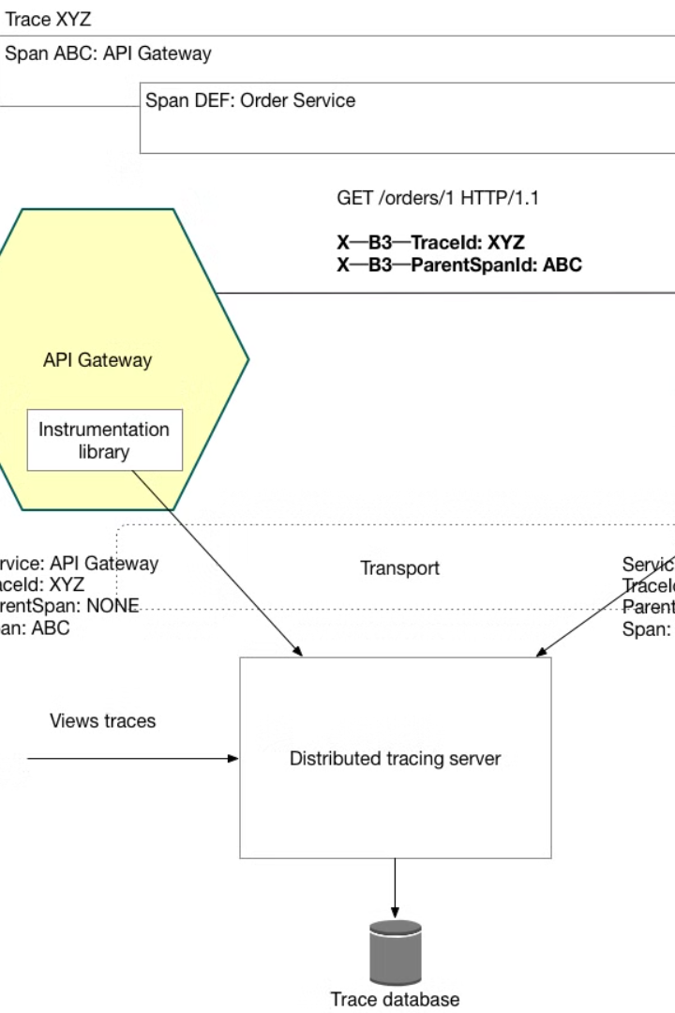




Instrumenting Your Applications for Distributed Tracing
Code Instrumentation
Tracing Libraries
Developers insert tracing code into their application, capturing relevant metadata and propagating trace context across service boundaries.
Tracing frameworks, such as OpenTelemetry or AWS X-Ray, provide libraries that simplify the instrumentation process and ensure consistent data collection.
Configuration Management
Automated Instrumentation
Maintaining and updating instrumentation configurations across a distributed system is crucial for effective distributed tracing.
Integrating instrumentation into your CI/CD pipeline can help ensure consistent and up-to-date tracing capabilities across your application.

Slide 25
Analyzing and Visualizing Trace Data
Trace Visualization
Trace Analysis
Alerting and Notifications
Distributed tracing systems provide intuitive visualizations, such as Gantt charts and service maps, to help teams understand the end-to-end flow of a request and identify performance bottlenecks.
Advanced analytical capabilities, including filtering, grouping, and correlation, empower teams to dive deep into the trace data, uncovering insights and patterns that can drive process improvements and optimize application performance.
Distributed tracing systems can be integrated with monitoring and alerting tools to proactively notify teams of performance issues or anomalies, enabling faster response and resolution times.

Slide 26
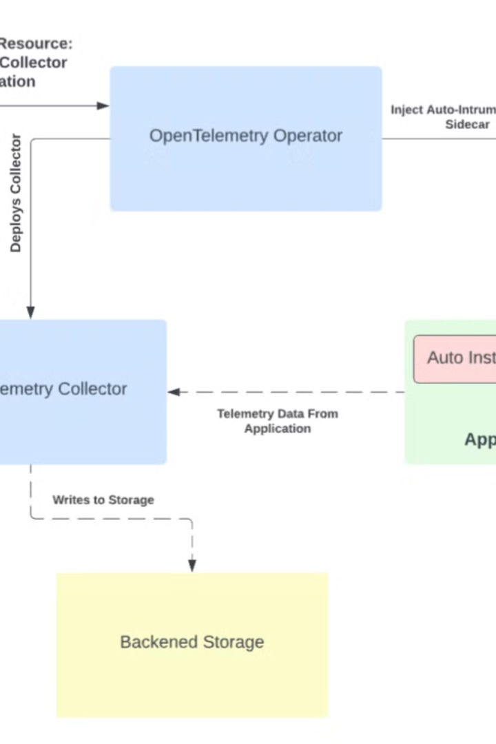



Troubleshooting and Root Cause Analysis
Identify the Issue
Trace visualizations and analytics help teams quickly identify the source of a problem, whether it's a slow-running service, an error-prone component, or a complex interaction between multiple services.
Investigate the Trace
By diving into the detailed trace data, teams can uncover the root cause of the issue, examining performance metrics, error messages, and other contextual information to understand what went wrong.
Resolve the Problem
Armed with a clear understanding of the problem, teams can then take targeted actions to fix the underlying issue, whether it's optimizing a slow-running service, addressing a bug, or improving the overall system design.

Slide 27
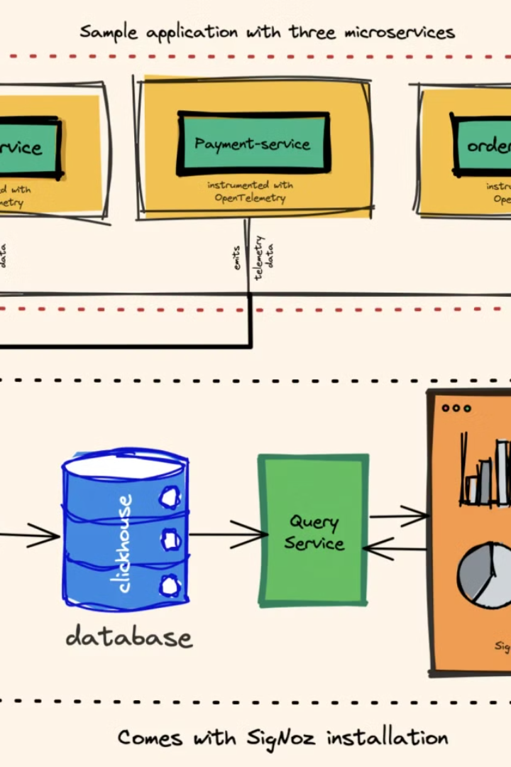
Advanced Use Cases of Distributed Tracing
1
Performance Optimization
2
Microservices Monitoring
Tracing the flow of requests through a microservices architecture provides valuable insights into the health, interactions, and dependencies of your individual services, enabling more effective monitoring and management.
Distributed tracing data can be used to identify performance bottlenecks, analyze the impact of changes, and measure the effectiveness of optimization efforts across your distributed application.
3
Distributed System Visualization
4
Anomaly Detection
By analyzing trace data patterns, distributed tracing systems can identify anomalies and outliers, alerting teams to potential issues before they escalate and impact end-users.
Distributed tracing tools can generate comprehensive service maps and dependency graphs, helping teams understand the complex relationships and interactions within their distributed systems.

Slide 28

Best Practices and Recommendations
Instrument Early
Incorporate distributed tracing into your application development lifecycle from the beginning to ensure consistent and comprehensive data collection.
Standardize Tracing
Adopt a common tracing framework, such as OpenTelemetry, to ensure interoperability and facilitate the exchange of tracing data across your organization.
Optimize for Performance
Carefully design your tracing implementation to minimize the performance impact on your application, especially in critical paths or high-traffic areas.
Leverage Automation
Integrate distributed tracing instrumentation into your CI/CD pipeline to ensure consistent and up-to-date tracing capabilities across your application landscape.

Slide 29
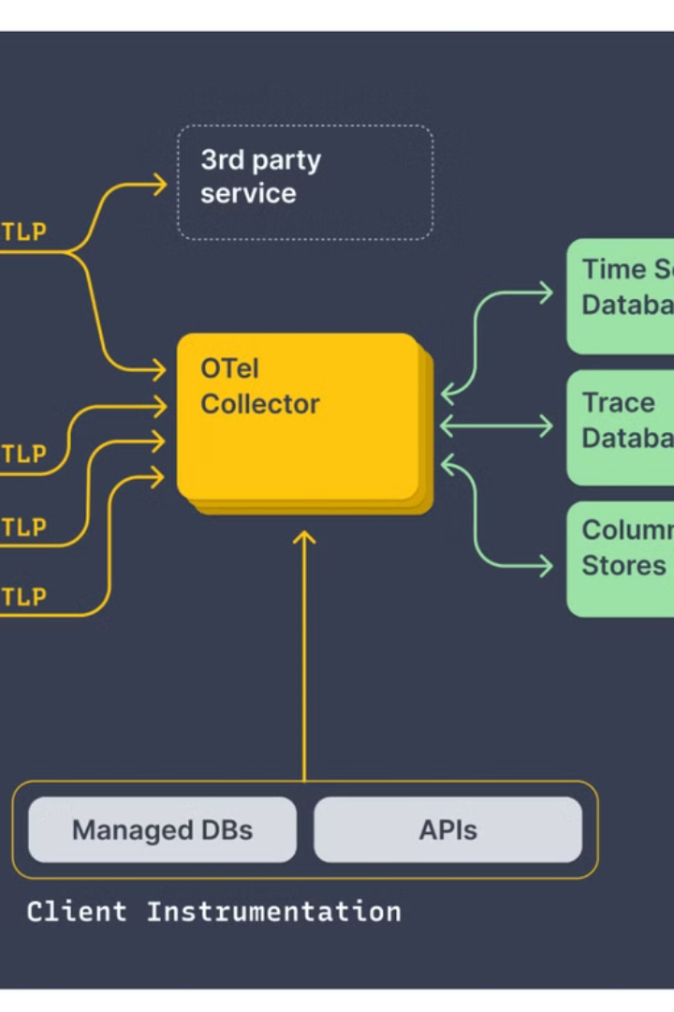
Introduction to OpenTelemetry and Jaeger
OpenTelemetry and Jaeger are powerful tools that work together to provide comprehensive distributed tracing capabilities. This presentation will explore their key features, benefits, and how to effectively implement them for monitoring and analyzing your applications.

Slide 30
Understanding Distributed Tracing
1
Capture Telemetry Data
Collect traces, metrics, and logs from your distributed applications.
2
Correlate and Analyze
Understand the relationships and dependencies between services.
3
Optimize Performance
Identify bottlenecks and issues to improve the overall application performance.

Slide 31
Key Features and Benefits of OpenTelemetry
Vendor-Neutral
Language Support
Scalable and Efficient
OpenTelemetry is an open-source and vendor-neutral instrumentation library that can be used with various monitoring platforms.
Supports multiple programming languages, enabling consistent tracing across your entire application stack.
Designed to handle high-volume data streams with low overhead, ensuring reliable and scalable performance.

Slide 32
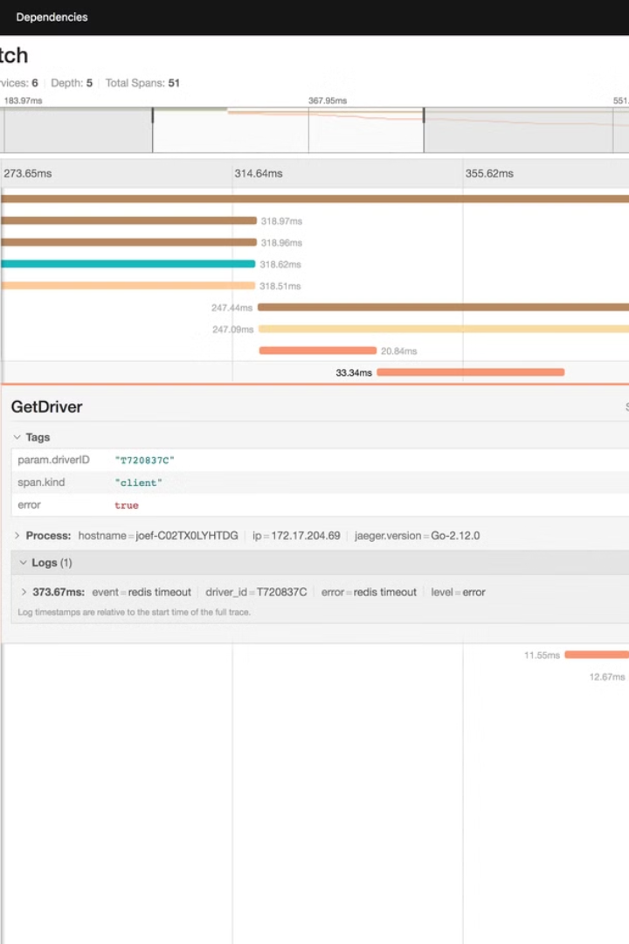
Jaeger: An Open-Source Distributed Tracing Platform
Flexible Backend
Intuitive UI
Jaeger supports various storage backends, including Elasticsearch, Cassandra, and memory, allowing you to choose the most suitable option.
The Jaeger user interface provides a user-friendly way to visualize, search, and analyze trace data.
Scalable Architecture
Open-Source
Jaeger's architecture is designed to handle high-volume trace data, ensuring reliable and scalable performance.
Jaeger is an open-source project, allowing for community contributions and customizations to meet your specific needs.

Slide 33
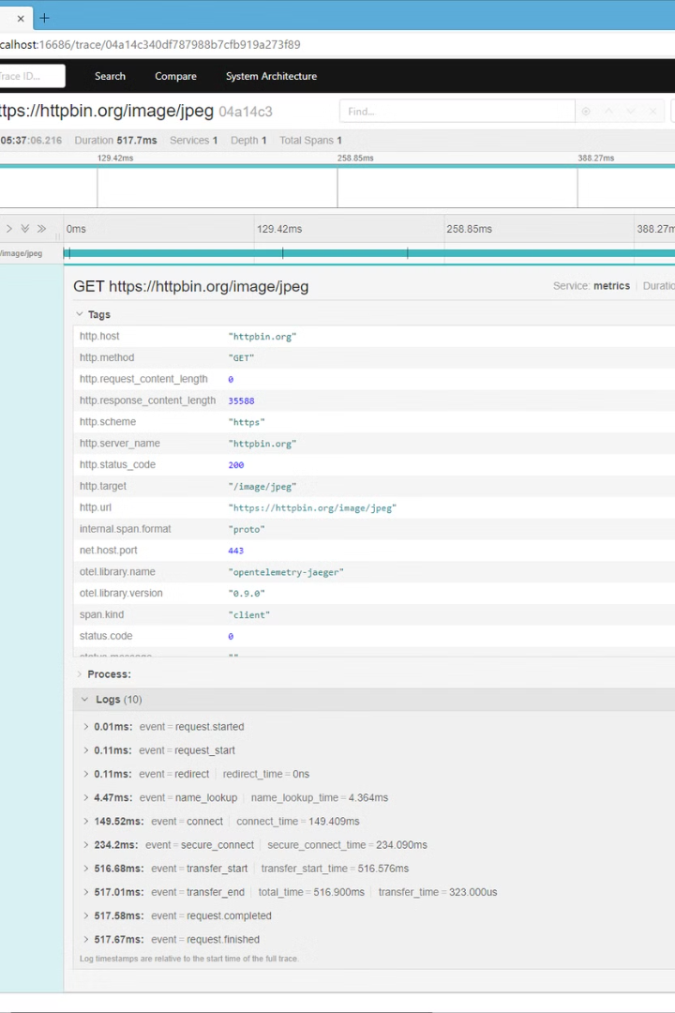
Integrating OpenTelemetry with Jaeger
Instrument
Use OpenTelemetry SDKs to instrument your applications and generate trace data.
Configure
Configure OpenTelemetry to export trace data to the Jaeger backend.
Visualize
Explore and analyze the trace data using the Jaeger user interface.

Slide 34
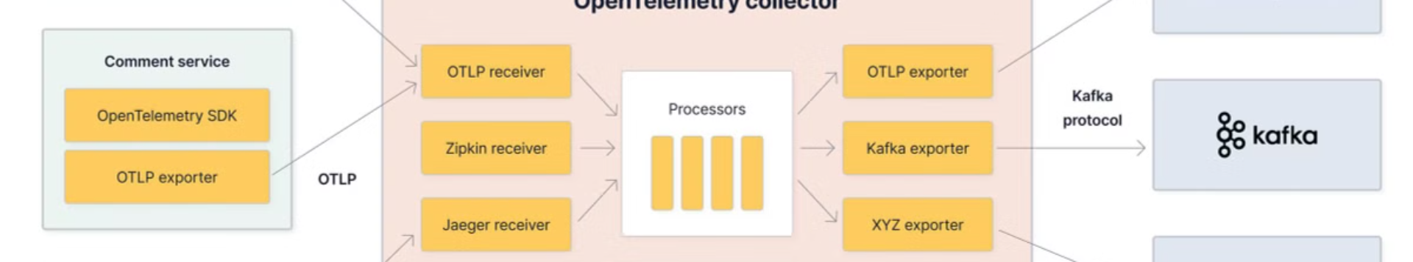




Instrumenting Your Applications with OpenTelemetry
SDK Libraries
Configuration
Automation
Monitoring
Integrate OpenTelemetry SDKs into your applications to generate trace data.
Configure the OpenTelemetry SDK to collect and export trace data.
Use automated instrumentation to quickly set up tracing without manual changes.
Monitor your application's performance and identify issues using trace data.

Slide 35
Visualizing and Analyzing Trace Data in Jaeger
Trace View
Service Map
Search and Filtering
The Jaeger UI provides a detailed view of individual traces, showing the timeline, spans, and related metadata.
Visualize the relationships and dependencies between services, helping to understand the overall application architecture.
Easily search and filter trace data to quickly identify and investigate performance issues or anomalies.

Slide 36
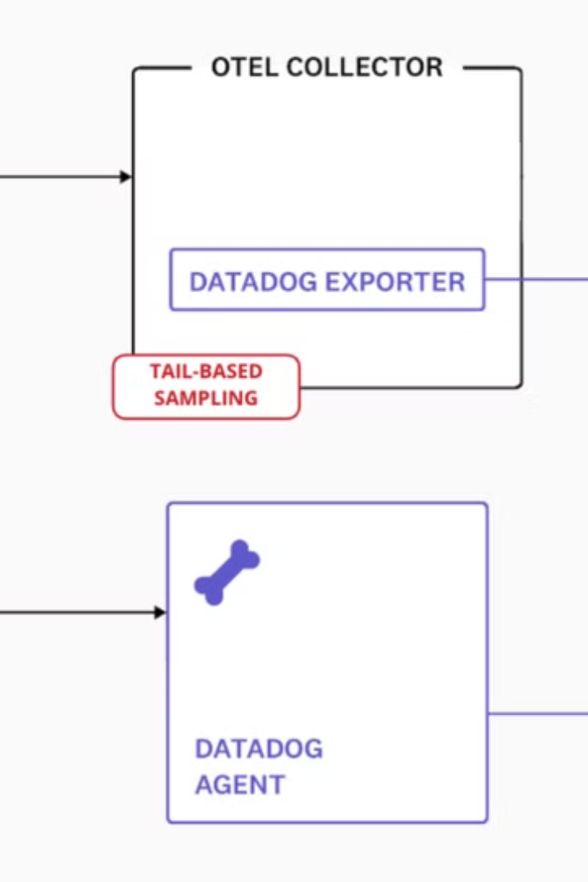
Advanced Capabilities: Sampling and Correlation
1
Adaptive Sampling
2
Correlation
OpenTelemetry and Jaeger provide robust correlation mechanisms to link related traces and span data.
Jaeger's adaptive sampling algorithms ensure that important traces are captured, even in high-volume environments.
3
Distributed Context
Maintain context across service boundaries, enabling end-to-end visibility and tracing of transactions.

Slide 37
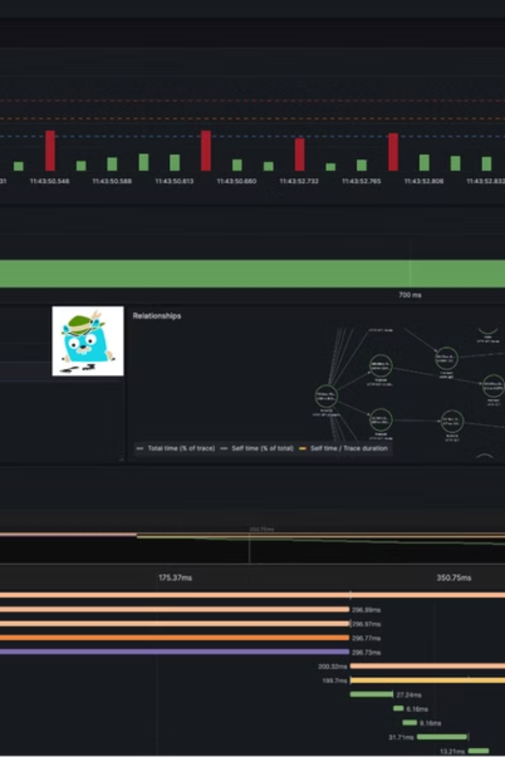
Best Practices for Effective Monitoring with OpenTelemetry and Jaeger
Instrument Early
Prioritize Instrumentation
Integrate OpenTelemetry into your applications during the early stages of development to ensure comprehensive tracing.
Focus on instrumenting critical services and high-traffic areas to maximize the value of your tracing data.
Continuous Improvement
Collaborate with Teams
Engage with cross-functional teams to ensure effective implementation and utilization of OpenTelemetry and Jaeger.
Regularly review and optimize your instrumentation and monitoring practices to adapt to changes in your application landscape.

Slide 38
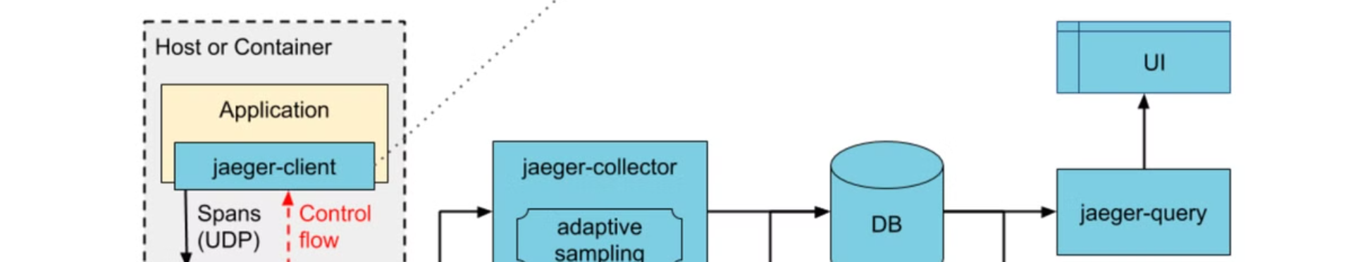
Conclusion and Next Steps
By leveraging the capabilities of OpenTelemetry and Jaeger, you can unlock powerful distributed tracing and monitoring capabilities for your applications. This presentation has covered the key features, benefits, and best practices to get started. Take the next step and explore how these tools can transform your application observability.

